Slide 1

epidemics on networks
Hairong Chen CSE&ISYE 2022

Slide 2
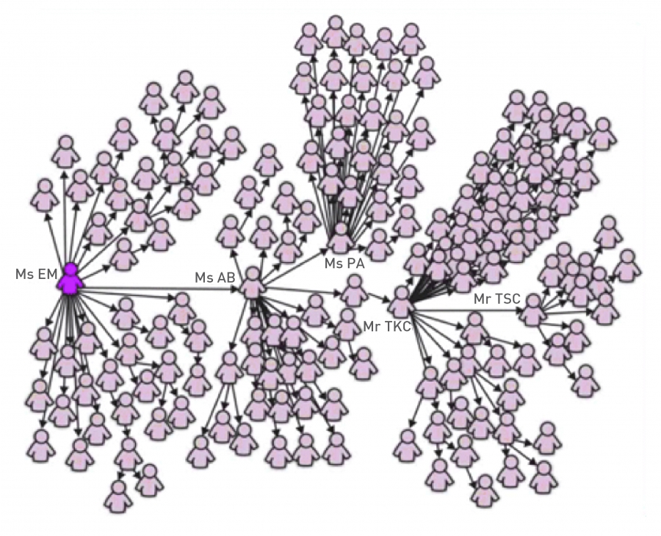
Introduction
A network theorist will recognize super-spreaders as hubs, nodes with an exceptional number of links in the contact network on which a disease spreads. As hubs appear in many networks, super-spreaders have been documented in many infectious diseases, from smallpox to AIDS. In this chapter we introduce a network-based approach to epidemic phenomena that allows us to understand and predict the true impact of these hubs. The resulting framework, that we call network epidemics, offers an analytical and numerical platform to quantify and forecast the spread of infectious diseases.
One-hundred-forty-four of the 206 SARS patients diagnosed in Singapore were traced to a chain of five individuals that included four super-spreaders. The most important of these was Patient Zero, the physician from Guangdong Province in China, who brought the disease to the Metropole Hotel.
Notes:
On the night of February 21, 2003, a physician from Guangdong Province in southern China checked into the Metropole Hotel in Hong Kong. He previously treated patients suffering from a disease that, lacking a clear diagnosis, was called atypical pneumonia. Next day, after leaving the hotel, he went to the local hospital, this time as a patient. He died there several days later of atypical pneumonia.
The physician did not leave the hotel without a trace: That night sixteen other guests of the Metropole Hotel and one visitor also contracted the disease that was eventually renamed Severe Acute Respiratory Syndrome, or SARS. These guests carried the SARS virus with them to Hanoi, Singapore, and Toronto, sparking outbreaks in each of those cities. Epidemiologists later traced close to half of the 8,100 documented cases of SARS back to the Metropole Hotel. With that the physician who brought the virus to Hong Kong become an example of a super-spreader, an individual who is responsible for a disproportionate number of infections during an epidemic.

Slide 3

Networks and agents
Infectious diseases account for 43% of the global burden of disease, as captured by the number of years of lost healthy life. They are called contagious, as they are transmitted by contact with an ill person or with their secretions.
Cures and vaccines are rarely sufficient to stop an infectious disease - it is equally important to understand how the pathogen responsible for the disease spreads in the population, which in turn determines the way we administer the available cures or vaccines.
The diversity of phenomena regularly described as spreading processes on networks is staggering:
Biological
Digital
Mobile Phone Viruses
Bluetooth (BT) Viruses
Multimedia Messaging Services (MMS)
Social
Notes:
The spread of pathogens on their respective contact network is the main subject of this chapter. Examples include airborne diseases like influenza, SARS, or tuberculosis, transmitted when two individuals breathe the air in the same room; contagious diseases and parasites transmitted when people touch each other; the Ebola virus, transmitted via contact with a patient's bodily fluids, HIV and other sexually transmitted diseases passed on during sexual intercourse. Infectious diseases also include cancers carried by cancer-causing viruses, like HPV or EBV, or diseases carried by parasites like bedbugs or malaria.
A computer virus is a self-reproducing program that can transmit a copy of itself from computer to computer. Its spreading pattern has many similarities to the spread of pathogens. But digital viruses also have many unique features, determined by the technology behind the specific virus. As mobile phones morphed into hand-held computers, lately we also witnessed the appearance of mobile viruses and worms that infect smartphones
Smart phones, capable of sharing programs and data with each other, offer a fertile ground for virus writers. Indeed, since 2004 hundreds of smart phone viruses have been identified, reaching a state of sophistication in a few years that took computer viruses about two decades to achieve [3]. Mobile viruses are transmitted using two main communication mechanisms:
A BT virus infects all phones found within BT range from the infected phone, which is about 10-30 meters. As physical proximity is essential for a BT connection, the transmission of a BT virus is determined by the owner’s location and the underlying mobility network, connecting locations by individuals who travel between them (SECTION 10.4). Hence BT viruses follow a spreading pattern like influenza.
Viruses carried by MMS can infect all susceptible phones whose number is in the infected phone’s phonebook. Hence MMS viruses spread on the social network, following a long-range spreading pattern that is independent of the infected phone’s physical location. Consequently, the spreading of MMS viruses is similar to the patterns characterizing computer viruses.
The role of the social and professional network in the spread and acceptance of innovations, knowledge, business practices, products, behavior, rumors and memes, is a much-studied problem in social sciences, marketing and economics [5, 6]. Online environments, like Twitter, offer unprecedented ability to track such phenomena. Consequently, a staggering number of studies focus on social spreading, asking for example why can some messages reach millions of individuals, while others struggle to get noticed.
The examples discussed above involve diverse spreading agents, from biological to computer viruses, ideas and products; they spread on different types of networks, from social to computer and professional networks; they are characterized by widely different time scales and follow different mechanisms of transmission. Despite this diversity, as we show in this chapter, these spreading processes obey common patterns and can be described using the same network-based theoretical and modeling framework.

Slide 4

Networks and Agents
Phenomena | Agent | Network
Venereal Disease | Pathogens | Sexual Network
Rumor Spreading | Information, Memes | Communication Network
Diffusion of Innovations | Ideas, Knowledge | Communication Network
Computer Viruses | Malwares, Digital viruses | Internet
Mobile Phone Virus | Mobile Viruses | Social Network/Proximity Network
Bedbugs | Parasitic Insects | Hotel - Traveler Network
Malaria | Plasmodium | Mosquito - Human network
The spread of a pathogen, a meme or a computer virus is determined by the network on which the agent spreads and the transmission mechanism of the responsible agent.
Notes:
The table lists several much-studied spreading phenomena, together with the nature of the spreading agent and the network on which the agent spreads.

Slide 5

Epidemic modeling
Epidemiology has developed a robust analytical and numerical framework to model the spread of pathogens. This framework relies on two fundamental hypotheses:
Compartmentalization
Epidemic models classify everyone based on the stage of the disease affecting them. The simplest classification assumes that an individual can be in one of three states or compartments:
  Susceptible (S): Healthy individuals who have not yet contacted the pathogen
  Infectious (I): Contagious individuals who have contacted the pathogen and hence can infect others.
  Recovered (R): Individuals who have been infected before, but have recovered from the disease, hence are not infectious.
Homogenous Mixing
The homogenous mixing hypothesis assumes that everyone has the same chance of meeting an infected individual. This hypothesis eliminates the need to know the precise contact network on which the disease spreads, replacing it with the assumption that anyone can infect anyone else.

Slide 6






Susceptible-Infected (SI) Model
N: individuals,
S(t): number of individuals who are susceptible (healthy),
t:time
I(t): the number individuals that have been already infected
<k>: contacts number
β: the probability that the disease will be transmitted from I to S in a unit time
Notes:
Consider a disease that spreads in a population of N individuals. Denote with S(t) the number of individuals who are susceptible (healthy) at time t and with I(t) the number individuals that have been already infected. At time t=0 everyone is susceptible (S(0)=N) and no one is infected (I(0)=0). Let us assume that a typical individual has 〈k〉 contacts and that the probability that the disease will be transmitted from an infected to a susceptible individual in a unit time is β. We ask the following: If a single individual becomes infected at time t=0 (i.e. I(0)=1), how many individuals will be infected at some later time t?
Within the homogenous mixing hypothesis the probability that the infected person encounters a susceptible individual is S(t)/N. Therefore the infected person comes into contact with 〈k〉S(t)/N susceptible individuals in a unit time. Since I(t) infected individuals are transmitting the pathogen, each at rate β, the average number of new infections dI(t) during a timeframe dt is
1 Consequently I(t) changes at the rate;
2 to capture the fraction of the susceptible and of the infected population at time t. For simplicity we also drop the (t) variable from i(t) and s(t);
3 where the product β〈k〉 is called the transmission rate or transmissibility, We solve this equation and get;
4 Integrating both sides, we obtain;
5 With the initial condition i₀= i(t=0), we get C=i₀/(1–i₀), obtaining that the fraction of infected individuals increases in time as

Slide 7
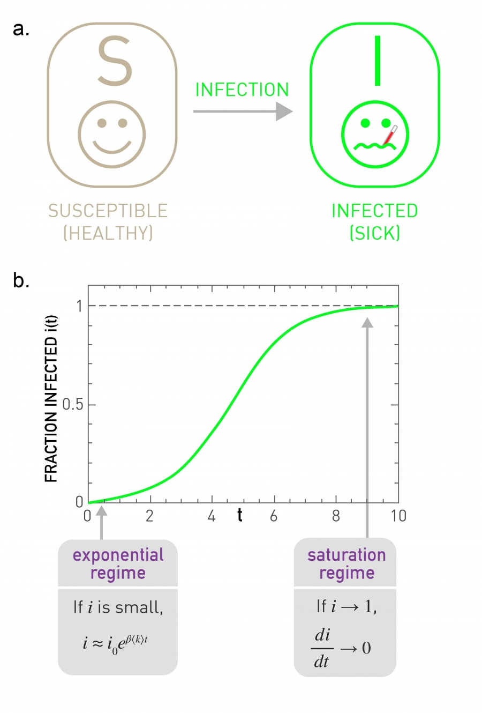

Susceptible-Infected (SI) Model
Equation predicts that:
The characteristic time required to reach 1/e fraction (about 36%) of all susceptible individuals is
With time an infected individual encounters fewer and fewer susceptible individuals. Hence the growth of i slows for large t. The epidemic ends when everyone has been infected, when i(t→∞)=1 and s(t→∞)=0.
Notes:
At the beginning the fraction of infected individuals increases exponentially. Indeed, early on an infected individual encounters only susceptible individuals, hence the pathogen can easily spread.
Hence τ is the inverse of the speed with which the pathogen spreads through the population. Equation (10.5) predicts that increasing either the density of links〈k〉 or β enhances the speed of the pathogen and reduces the characteristic time.
In the SI model an individual can be in one of two states: susceptible (healthy) or infected (sick). The model assumes that if a susceptible individual comes into contact with an infected individual, it becomes infected at rate β. The arrow indicates that once an individual becomes infected, it stays infected, hence it cannot recover.
Time evolution of the fraction of infected individuals, as predicted by (10.4). At early times the fraction of infected individuals grows exponentially. As eventually everyone becomes infected, at large times we have i(∞)=1.

Slide 8
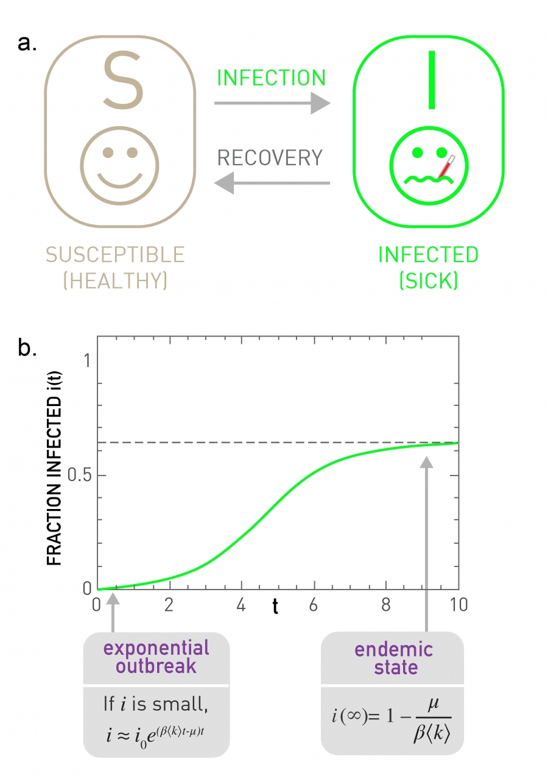



Susceptible-Infected-Susceptible (SIS) Model
SIS model, which has the same two states as the SI model, susceptible and infected.
The difference is that now infected individuals recover at a fixed rate μ, becoming susceptible again.
The equation describing the dynamics of this model is an extension of
Notes:
Most pathogens are eventually defeated by the immune system or by treatment. To capture this fact we need to allow the infected individuals to recover, ceasing to spread the disease.
where μ is the recovery rate and the μi term captures the rate at which the population recovers from the disease. The solution of provides the fraction of infected individuals in function of time
The SIS model has the same states as the SI model: susceptible and infected. It differs from the SI model in that it allows recovery, i.e. infected individuals are cured, becoming susceptible again at rate μ.
Time evolution of the fraction of infected individuals in the SIS model, as predicted by (10.7). As recovery is possible, at large t the system reaches an endemic state, in which the fraction of infected individuals is constant, i(∞), given by equation. Hence in the endemic state only a finite fraction of individuals are infected. Note that for high recovery rate μ the number of infected individuals decreases exponentially, and the disease dies out.

Slide 9
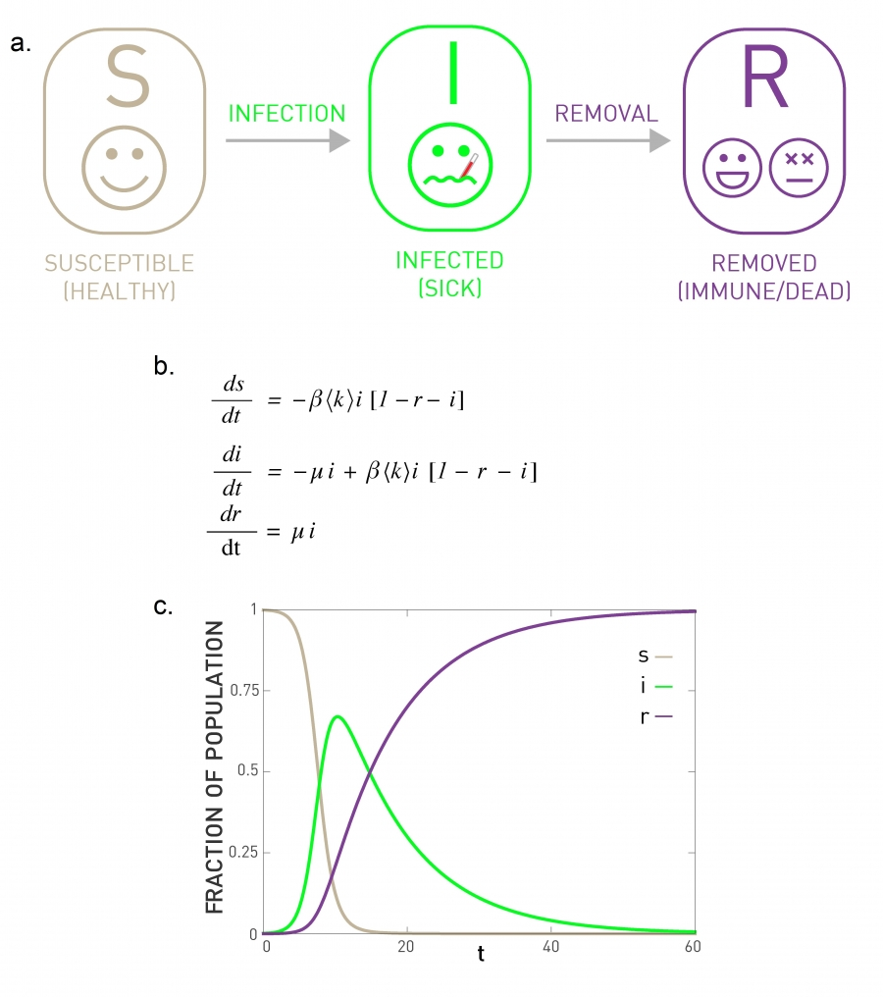
Susceptible-Infected-Recovered (SIR) Model
In contrast with the SIS model, in the SIR model recovered individuals enter a recovered state, meaning that they develop immunity rather than becoming susceptible again. Flu, SARS and Plague are diseases with this property; hence we must use the SIR model to describe their spread.
The differential equations governing the time evolution of the fraction of individuals in the susceptible s, infected i and the removed r state.
The time dependent behavior of s, i and r as predicted by the equations shown in (b). According to the model all individuals transition from a susceptible (healthy) state to the infected (sick) state and then to the recovered (immune) state.
Notes:
In contrast with the SIS model, in the SIR model recovered individuals enter a recovered state, meaning that they develop immunity rather than becoming susceptible again. Flu, SARS and Plague are diseases with this property, hence we must use the SIR model to describe their spread.
The differential equations governing the time evolution of the fraction of individuals in the susceptible s, infected i and the removed r state.
The time dependent behavior of s, i and r as predicted by the equations shown in (b). According to the model all individuals transition from a susceptible (healthy) state to the infected (sick) state and then to the recovered (immune) state.

Slide 10
Network Epidemics
The epidemic models discussed in the previous section do not incorporate the structure of the contract network that facilitates the spread of a pathogen. Instead, they assume that any individual can meet any other individual (homogenous mixing hypothesis) and that all individuals have comparable number of contacts, 〈k〉. However, Individual can transmit a pathogen only to those they contact with, hence pathogens spread on a complex contact network. Furthermore, these contact networks are often scale-free, hence 〈k〉 is not sufficient to characterize their topology.
The failure of the basic hypotheses prompted a fundamental revision of the epidemic modeling framework. This change began with the work of Romualdo Pastor-Satorras and Alessandro Vespignani, who in 2001 extended the basic epidemic models to incorporate in a self-consistent fashion the topological characteristics of the underlying contact network.

Slide 11
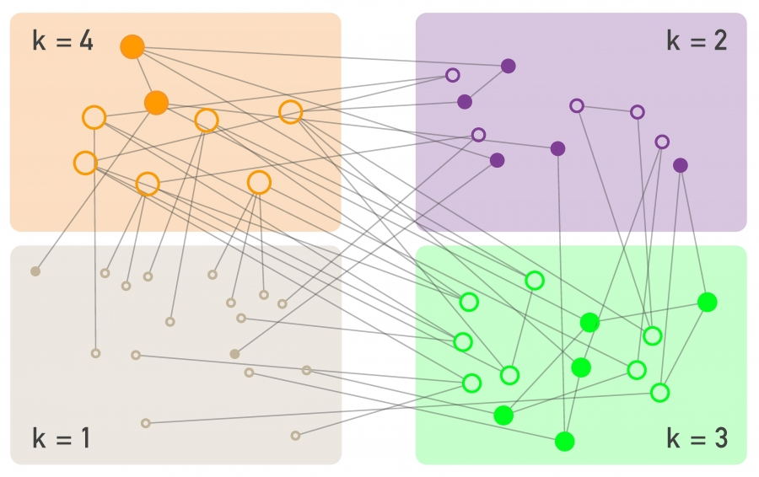



Susceptible-Infected (SI) Model on a Network
achieved by the degree block approximation, that distinguishes nodes based on their degree and assumes that nodes with the same degree are statistically equivalent
degree block approximation
Notes:
If a pathogen spreads on a network, individuals with more links are more likely to be in contact with an infected individual, hence they are more likely to be infected. Therefore the mathematical formalism must consider the degree of each node as an implicit variable.
To account for the role of the network topology, the degree block approximation adds an additional set of compartments, placing all nodes that have the same degree into the same block. In other words, we assume that nodes with the same degree behave similarly. This allows us to write a separate rate equation for each degree.
Therefore we denote with
the fraction of nodes with degree k that are infected among all N_{k} degree-k nodes in the network. The total fraction of infected nodes is the sum of all infected degree-k nodes
Given the different node degrees, we write the SI model for each degree k/ separately:
This equation has the same structure as (10.3): The infection rate is proportional to β and the fraction of degree-k nodes that are not yet infected, which is (1-i_{k}). Yet, there are some key differences:
The average degree 〈k〉 in (10.3) is replaced with each node’s actual degree k.
The density function Θ_{k} represents the fraction of infected neighbors of a susceptible node k. In the homogenous mixing assumption Θ_{k} is simply the fraction of the infected nodes, i. In a network environment, however, the fraction of infected nodes in the vicinity of a node can depend on the node’s degree k and time t.
While (10.3) captures with a single equation the time dependent behavior of the whole system, (10.13) represents a system of k_{max} coupled equations, one equation for each degree present in the network.

Slide 12





We start by exploring the early time behavior of ik, a choice driven by both theoretical interest and practical considerations.
At the beginning of the epidemic ik is small and the higher order term in (10.13) βikkΘk can be neglected. Hence we can approximate (10.13) with
Notes:
Indeed, developing vaccines, cures, and other medical interventions for a new pathogen can take months to years. If we lack a cure, the only way to alter the course of an epidemic is to do so early, using quarantine, travel restrictions and transmission-slowing measures to halt its spread. To make the right decision about the nature, the timing and the magnitude of each intervention, we need an accurate estimate of the number of individuals infected in the early stages of the epidemic.
As we show in ADVANCED TOPICS 10.B, for a network lacking degree correlations the Θ_{k} function is independent of k, so using (10.40), (10.14) becomes
where τ^{SI} is the characteristic time for the spread of the pathogen
Integrating (10.15) we obtain the fraction of infected nodes with degree k

Slide 13
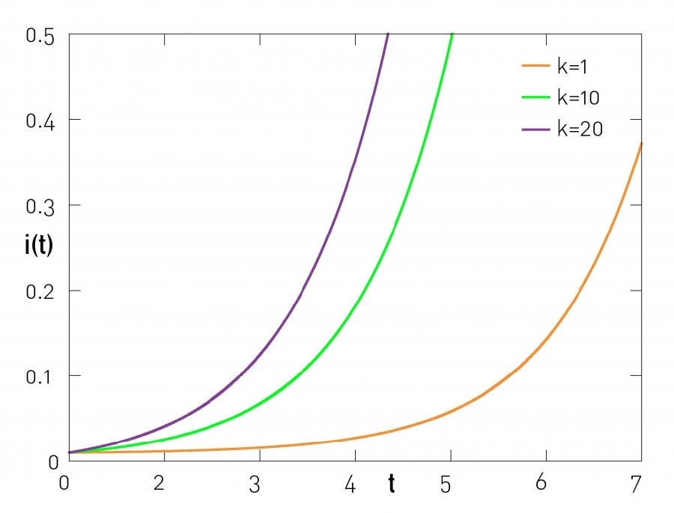
The higher the degree of a node, the more likely that it becomes infected. Indeed, for any time t we can write (10.17) as i_{k}=g(t)+kf(t), indicating that the group of nodes with higher degree has a higher fraction of infected nodes

Slide 14

SI model on different networks
Random network
For a random network 〈k2〉=〈k〉(〈k〉+1), obtaining
Scale-free Network with γ≥3
τ^{SI} is also finite and the spreading dynamics is similar to the behavior predicted for a random network but with an altered τ^{SI}.
Scale-free Networks with γ≤3
For γ < 3 in the N→∞ limit 〈k²〉→∞ hence (10.16) predicts τ^{SI}→0.
Inhomogeneous Networks
A network does not need to be strictly scale-free for the impact of the degree heterogeneity to be detectable.
Indeed, predicts that as long as 〈k²〉 > 〈k〉(〈k〉+1), τ^{SI} is reduced.
Notes:
recovering the result (10.5) for homogenous networks.
If the contract network on which the disease spreads is scale-free with degree exponent γ ≥3, both 〈k〉 and 〈k²〉 are finite.
In other words, the spread of a pathogen on a scale-free network is instantaneous. This is perhaps the most unexpected prediction of network epidemics.
Hence heterogenous network enhance the speed of any pathogen.

Slide 15



SIS Model and the Vanishing Epidemic Threshold
The continuum equation describing the dynamics of the SIS model on a network is a straightforward extension of the SI model discussed
The difference between (10.13) and (10.20) is the presence of the recovery term -µik. This changes the characteristic time of the epidemic to
For sufficiently large µ the characteristic time is negative, hence i_{k} decays exponentially. The condition for the decay depends not only on the recovery rate and 〈k〉, but also on the network heterogeneity, through 〈k²〉. To predict when a pathogen persists in the population, we define the spreading rate

Slide 16


SIS model on Random network
If a pathogen spreads on a random network, we can use 〈k²〉=〈k〉 (〈k+1〉) from
obtaining that the pathogen persists in the population if
Using to obtain as well as the
epidemic threshold of a random network
Notes:
If the spreading rate λ exceeds the epidemic threshold λ_{c}, the pathogen will spread until it reaches an endemic state, where a finite fraction i(λ) of the population is infected at any time.
If λ < λ_{c}, the pathogen dies out, i.e. i(λ)=0.

Slide 17


SIS model on scale-free network
For a network with an arbitrary degree distribution, we set τSIS > 0 from
, obtaining the epidemic threshold as
As for a scale-free network 〈k2〉 diverges in the N→∞ limit, for large networks the
epidemic threshold is expected to vanish.
Notes:
This means that even viruses that are hard to pass from individual to individual can spread successfully, representing the second fundamental prediction of network epidemics.

Slide 18
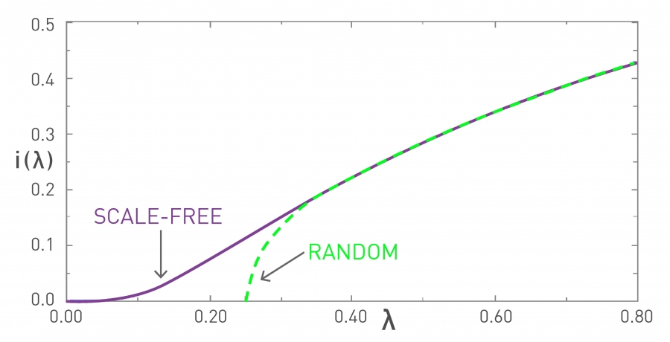
Epidemic Threshold
The fraction of infected individuals i(λ)=i(t→∞) in the endemic state of the SIS model. The curves are for a random (green) and for a scale-free contact network (purple). The random network has a finite epidemic threshold λ_{c}, implying that a pathogen with a small spreading rate (λ < λ_{c}) must die out, i.e. i(λ_{c})=0. If, however, the spreading rate of the pathogen exceeds λ_{c}, the pathogen becomes endemic and a finite fraction of the population is infected at any time. For a scale-free network we have λ_{c}=0, hence even viruses with a very small spreading rate λ can persist in the population.
Notes:
the epidemic threshold allows us to decide if a pathogen can or cannot persist in a population. This transition from the absence to the presence of an epidemic outbreak by increasing the spreading rate λ is at the basis of most campaigns to stop a pathogen

Slide 19
In a large scale-free network τ=0, which means that a virus can instantaneously reach most nodes.
In a large scale-free network λ_{c}=0, which means that even viruses with small spreading rate can persist in the population.
Notes:
In summary, the results of this section show that accounting for the network topology greatly alters the predictive power of the epidemic models. We derived two fundamental results:
Both results are the consequence of hubs’ ability to broadcast a pathogen to a large number of other nodes.

Slide 20
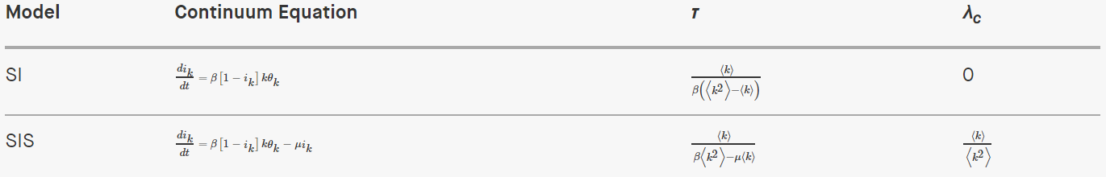
summary
The table shows the rate equation for the two basic epidemic models (SI, SIS) on a network with arbitrary 〈k〉 and 〈k²〉, together with the corresponding characteristic τ and the epidemic threshold λ_{c}. For the SI model λ_{c} =0, as in the absence of recovery (µ=0) a pathogen spreads until it reaches all susceptible individuals.
Notes:
Note that these results are not limited to scale-free networks. Rather (10.16) and (10.26) predict that both τ and λ_{c} depend on 〈k²〉, hence the effects discussed above will impact any network with high degree heterogeneity. In other words, if 〈k²〉 is larger than the random expectation 〈k〉(〈k+1〉), we will observe an enhanced spreading process, resulting in a smaller τ and λ_{c} than predicted by the traditional epidemic models. As this implies a faster spread of the pathogen than predicted by the traditional epidemic models, efforts to control an epidemic cannot ignore this difference.

Slide 21
THANK YOU!

